Slide 1

Logistics & Delivery Time Optimization
Power BI Dashboard | Presented by Jesmaa E

Slide 2


Project Overview: Unifying Delivery Performance
A centralized dashboard for critical insights.
Unified Performance Monitoring
Track key delivery metrics in one place.
Combined Datasets
Deliveries, vehicles, packages, and weather data merged.
Python for Data Prep
Cleaned and prepared data using Google Colab.
Power BI Visualizations
Actionable insights for informed decision-making.

Slide 3
Business Context: The Urgency of Efficiency
Logistics delays directly impact customer satisfaction and operational costs.
Delay Impacts
Rising Demand
Data-Driven Optimization
High costs and reduced customer loyalty.
Need for speed and reliability in delivery.
Across regions and diverse delivery modes.

Slide 4

Data Preparation: Ensuring Robust Analytics
Clean, standardized data is the foundation of reliable insights.
Cleanse Data
Removed duplicates, nulls, and outliers.
Encode Variables
Categorical data for vehicle and delivery modes.
Standardize Fields
Consistent time and cost metrics.
Analysis-Ready
Dataset prepared for Power BI.

Slide 5
Step 1: Import & Inspect
Imported libraries (pandas, numpy)
Uploaded raw dataset (Delivery_Logistics.csv) in Google Colab
Performed initial checks:
df.head() → preview data
df.shape, df.info() → structure & size
df.isnull().sum() → missing values
df.describe() → summary statistics

Slide 6
Step 2: Transform & Clean
Converted delivery and expected time columns into datetime format
Created delivery_difference and delay flag (Late / On‑Time)
Dropped missing values (dropna())
Removed duplicates (drop_duplicates())
Verified integrity with duplicate count

Slide 7
Step 3: Export Clean Data
Re‑checked cleaned dataset (df.head(), df.info())
Saved as Clean_Delivery_Data.csv (to_csv())
Downloaded for use in Power BI dashboard

Slide 8
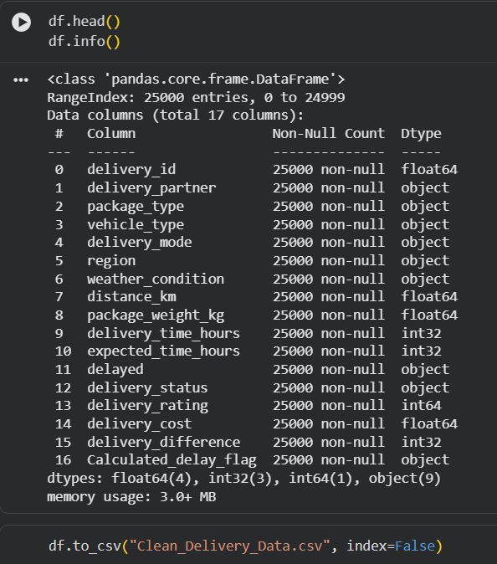

Slide 9
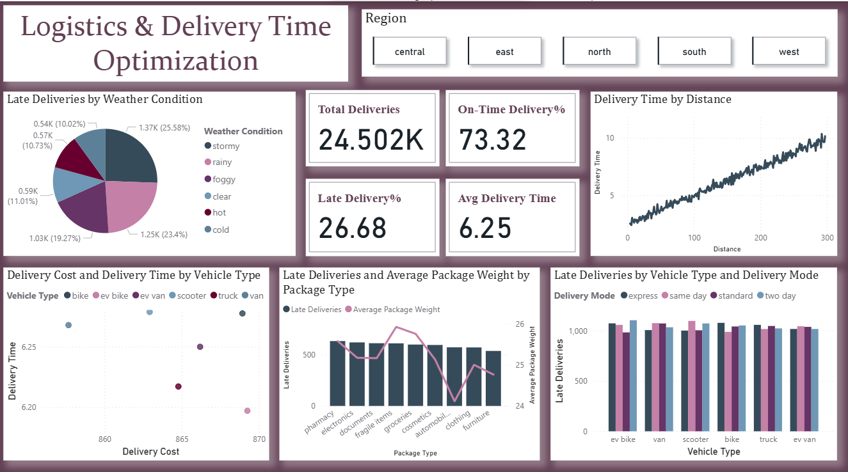
Charts
Late Deliveries by Weather Condition (Pie Chart)
Insight: Weather significantly impacts delivery reliability.
Findings: Cold (25.6%) and Hot (23.4%) conditions drive the highest delays.
Business Impact: Seasonal planning and weather‑adaptive routing are critical.
Action: Integrate predictive weather data into scheduling.

Slide 10
Delivery Cost & Time by Vehicle Type (Scatter Plot)
Insight: Vehicle choice directly affects both cost and speed.
Findings: EV bikes and scooters are cost‑efficient and fast; trucks/vans are slower and more expensive.
Business Impact: Fleet composition influences profitability.
Action: Expand EV fleet for short‑range deliveries, reserve trucks for heavy loads

Slide 11
Delivery Time by Distance (Line Chart)
Insight: Strong positive correlation between distance and delivery time.
Findings: Longer routes consistently increase delays.
Business Impact: Route optimization is essential to reduce time.
Action: Implement dynamic routing algorithms and regional hubs.

Slide 12
Late Deliveries & Avg Package Weight by Package Type (Bar + Line Chart)
Insight: Package type and weight drive lateness.
Findings: Furniture and automobiles show highest delays due to heavy weight.
Business Impact: Heavy packages strain delivery timelines.
Action: Assign specialized vehicles and prioritize load balancing.

Slide 13
Late Deliveries by Vehicle Type & Delivery Mode (Bar Chart)
Insight: Delivery mode strongly influences timeliness.
Findings: Express mode consistently outperforms standard/two‑day.
Business Impact: Mode selection impacts customer satisfaction.
Action: Promote express for critical deliveries, optimize standard mode processes.

Slide 14

Key Delivery Performance Metrics
Snapshot of our current operational efficiency.
24.5K
73.3%
26.7%
6.25
Total Deliveries
On-Time Delivery
Late Deliveries
Avg. Delivery Time (hours)
Across all regions and modes.
Current success rate.
Areas for immediate improvement.
End-to-end process.
Regions Covered: Central, East, North, South, West.

Slide 15
Slicer
Filters by Region – Central, East, North, South, West
Refines Metrics – Updates KPIs and charts based on selected geography
Highlights Variability – Reveals performance gaps across regions
Supports Targeted Action – Enables region-specific analysis and optimization

Slide 16
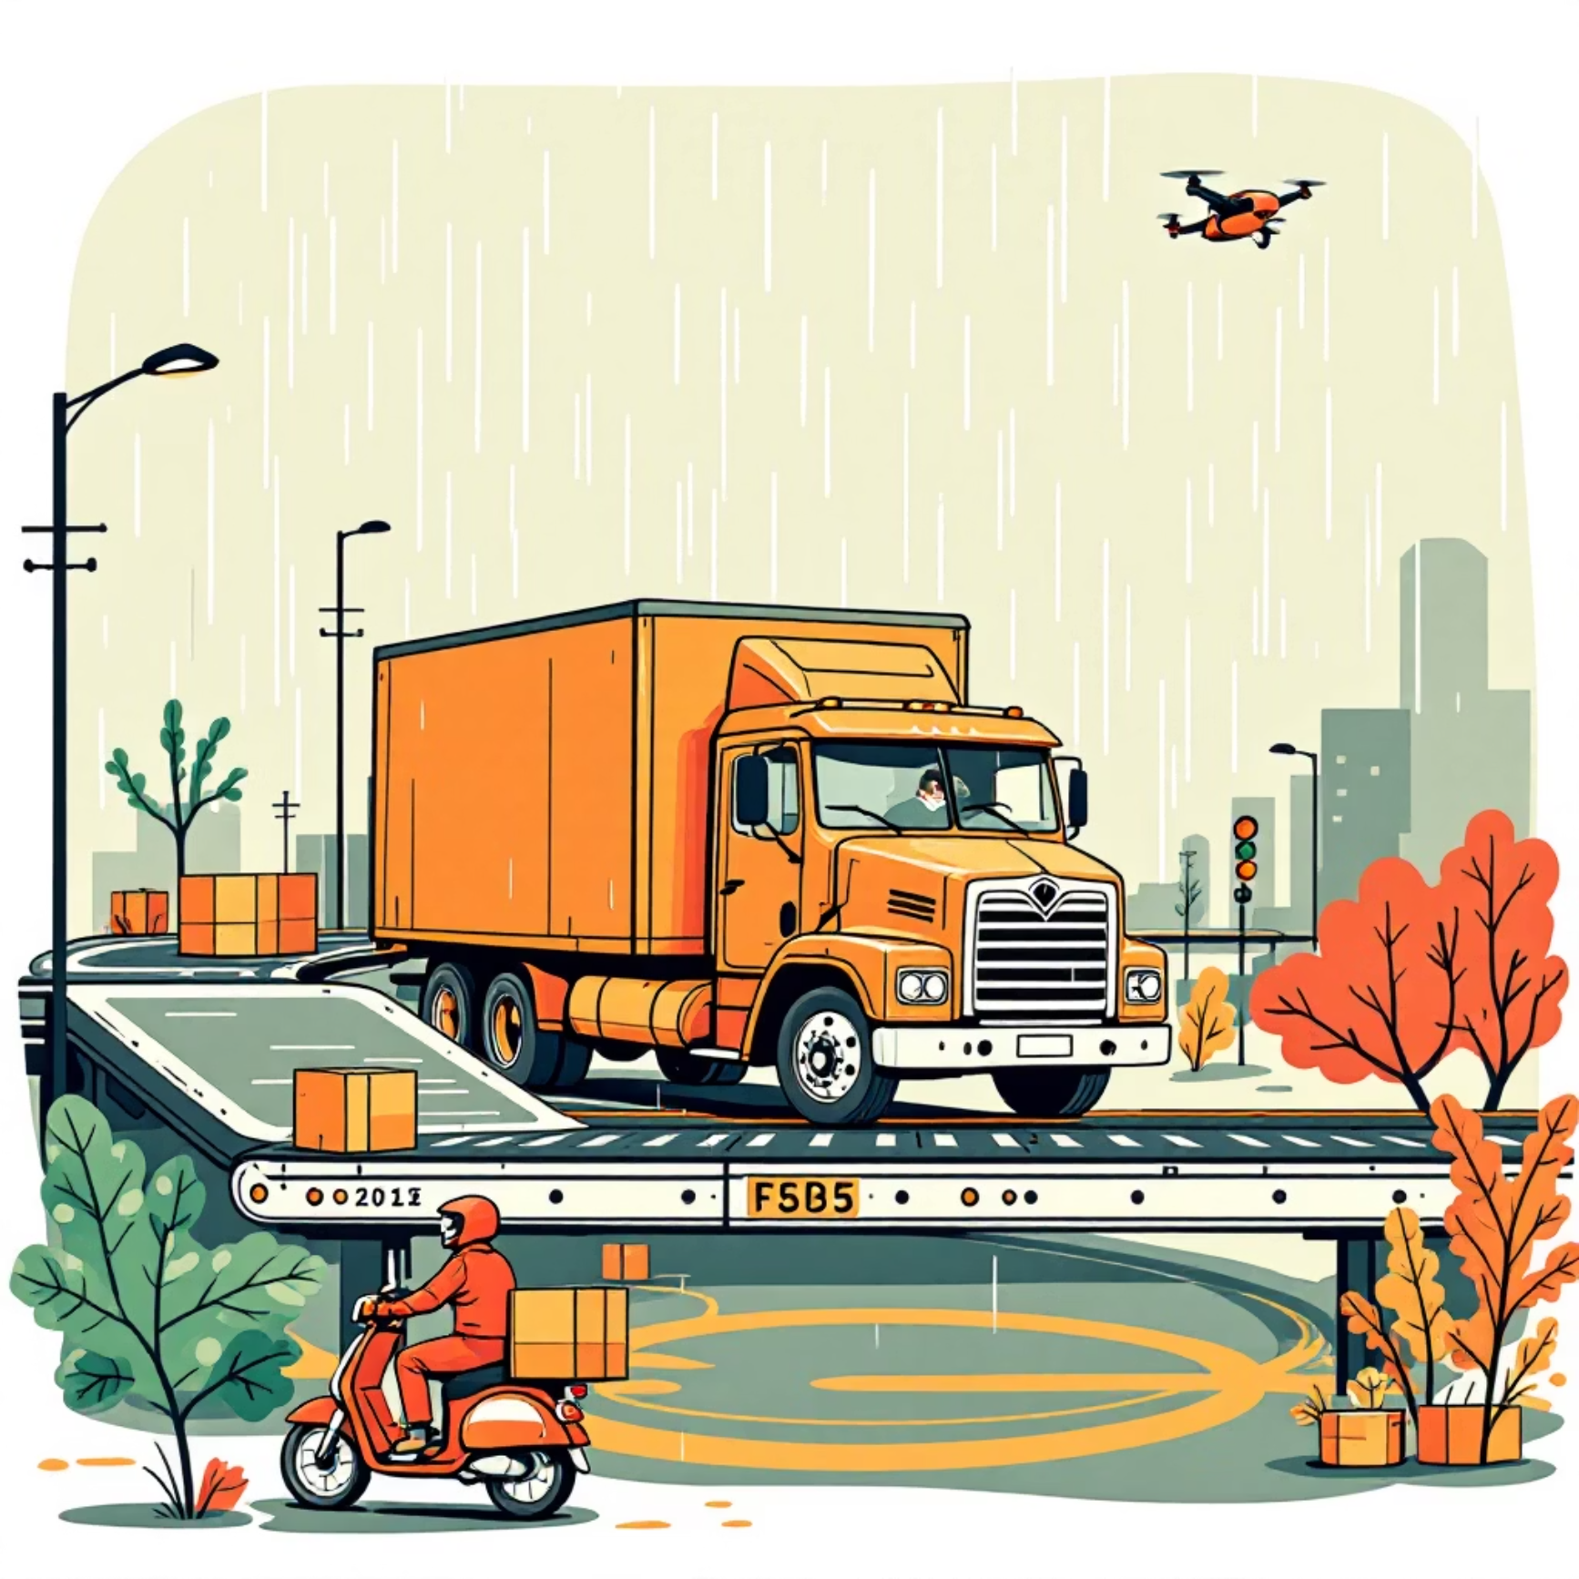
Operational Drivers of Delivery Performance
Factors significantly impacting timeliness and cost.
1
Weather Conditions
Major contributor to delays.
2
Vehicle Type
Influences both cost and speed.
3
Heavy Packages
Furniture, autos increase late rates.
4
Delivery Mode
Express vs. Standard reliability.

Slide 17
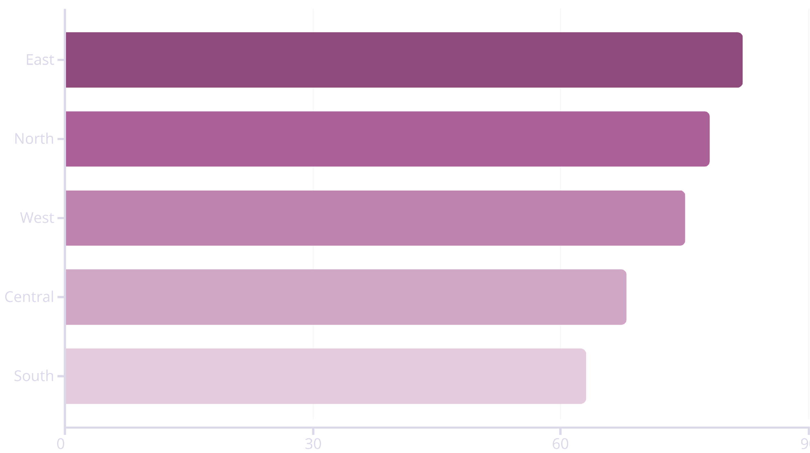
Regional Performance Benchmarking
Identifying best practices for wider implementation.
Significant variability in on-time rates exists. Higher performing regions present an opportunity to analyze and replicate successful strategies, while lower performing regions require targeted intervention.

Slide 18

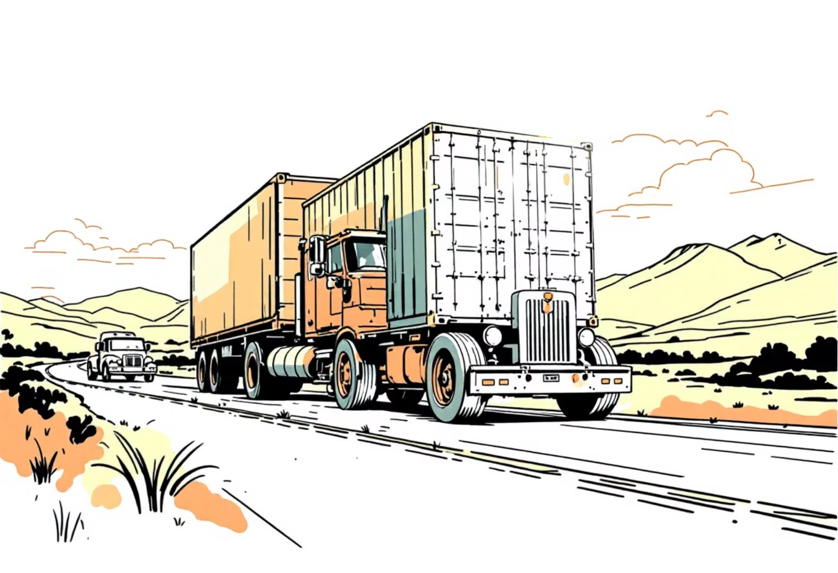
Cost & Efficiency Analysis by Vehicle
Optimizing fleet mix for maximum impact.
EV Bikes & Scooters
Trucks & Vans
High cost-time efficiency for short-range and express deliveries.
Higher cost, but essential for heavy and bulky loads.
Strategic balancing of the fleet mix is crucial for overall optimization.

Slide 19
Strategic Goals for Logistics Optimization
Driving significant improvements in delivery performance.
On-Time Delivery
Achieve 85%+ success rate.
Average Delivery Time
Reduce below 5 hours.
Vehicle Allocation
Optimize by package type and distance.
Predictive Analytics
Integrate for weather and traffic.

Slide 20

Recommendations & Next Steps
Actionable strategies for immediate implementation and future growth.
Expand EV Fleet
Automate Alerts
For short-range, express deliveries.
For delay-prone routes.
Scale Dashboard
Specialized Vehicles
Include cost KPIs and real-time monitoring.
Assign for heavy packages.
Investigate Delays
Address process inefficiencies in clear weather.

Slide 21
Thank You
Thank You

